Slide 1
Pb edge detection
Supervised Learning of edges and object boundaries

Slide 2

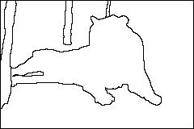
Why edges?
Reduce dimensionality of data
Preserve content information
Useful in applications such as:
object detection
structure from motion
tracking

Slide 3
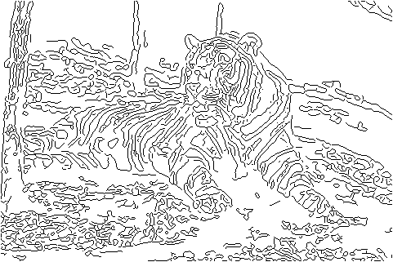
Why not edges?
But, not that useful, why?
Difficulties:
Modeling assumptions
Parameters
Multiple sources of information (brightness, color, texture, …)
Real world conditions
Is edge detection even well defined?

Slide 4
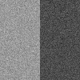

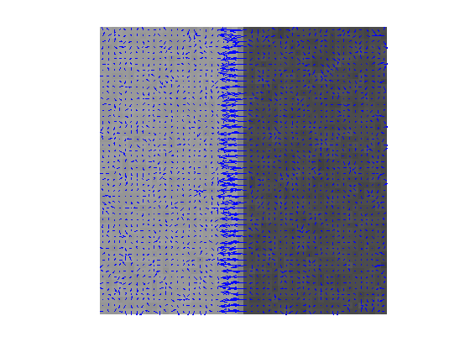

Canny edge detection
1. smooth
2. gradient
3. thresh, suppress, link
Canny is optimal w.r.t. some model.

Slide 5


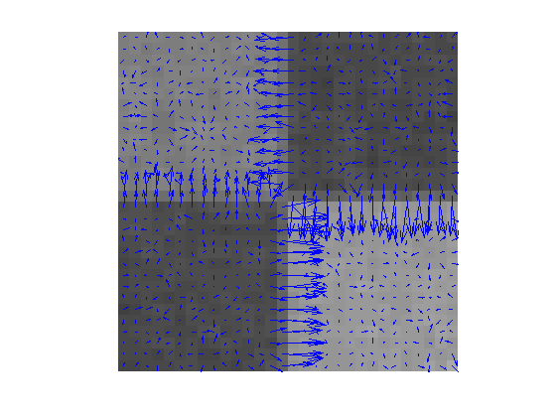

Canny edge detection
1. smooth
2. gradient
3. thresh, suppress, link
And yet…

Slide 6
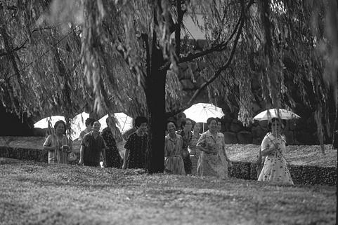
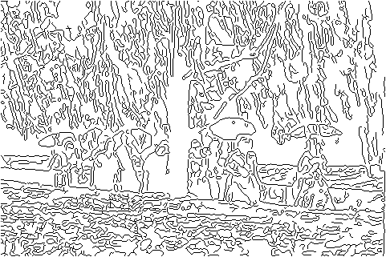
Canny difficulties
Modeling assumptions
Step edges, junctions, etc.
Parameters
Scales, threshold, etc.
Multiple sources of information
Only handles brightness
Real world conditions
Gaussian iid noise? Texture…

Slide 7
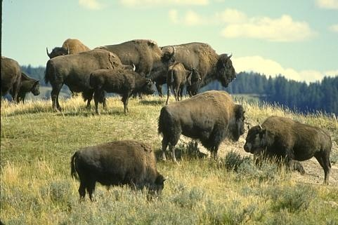
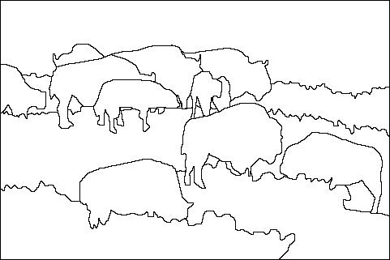
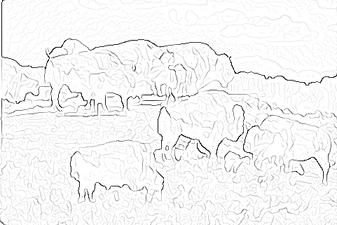


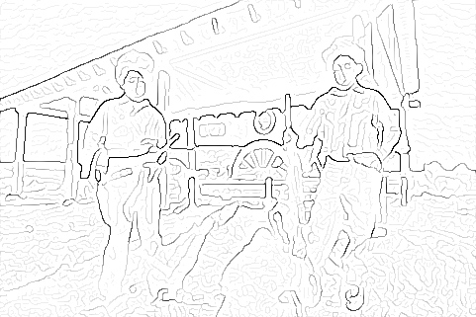
Learning to detect boundaries
image
human segmentation
gradient magnitude
Berkeley segmentation database: http://www.eecs.berkeley.edu/Research/Projects/CS/vision/grouping/segbench/

Slide 8
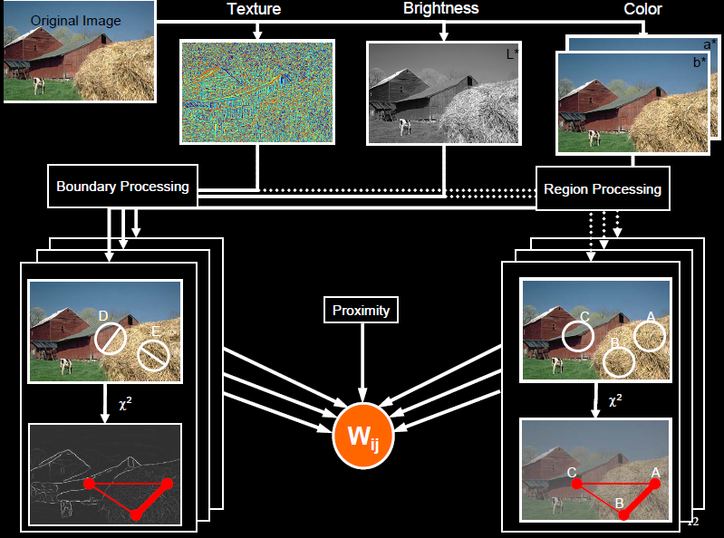
pB boundary detector
Martin, Fowlkes, Malik 2004: Learning to Detection Natural Boundaries…
http://www.eecs.berkeley.edu/Research/Projects/CS/vision/grouping/papers/mfm-pami-boundary.pdf
Figure from Fowlkes

Slide 9
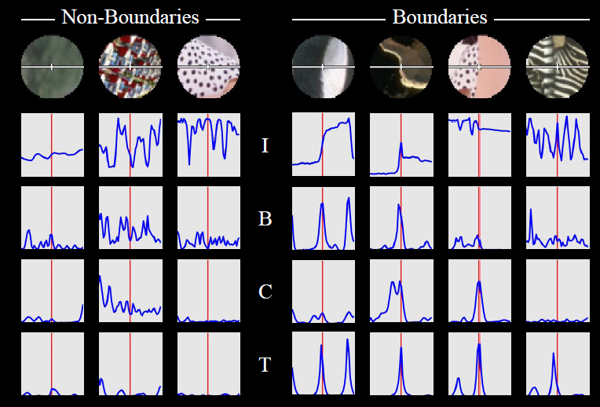
pB Boundary Detector
- Estimate Posterior probability of boundary passing through centre point based on local patch based features
- Using a Supervised Learning based framework

Slide 10
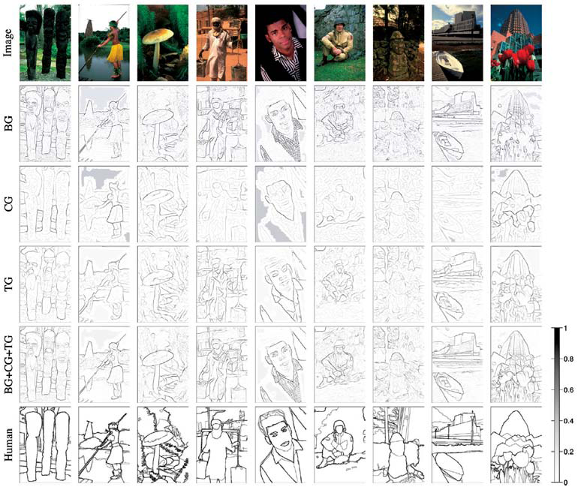
Brightness
Color
Texture
Combined
Human

Slide 11

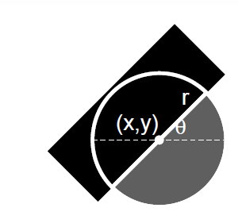
Features
Brightness oriented energy,
Gradients computed from two disc halves:
Brightness gradient
Color gradient
Texture gradient
Gaussian second derivative

Slide 12
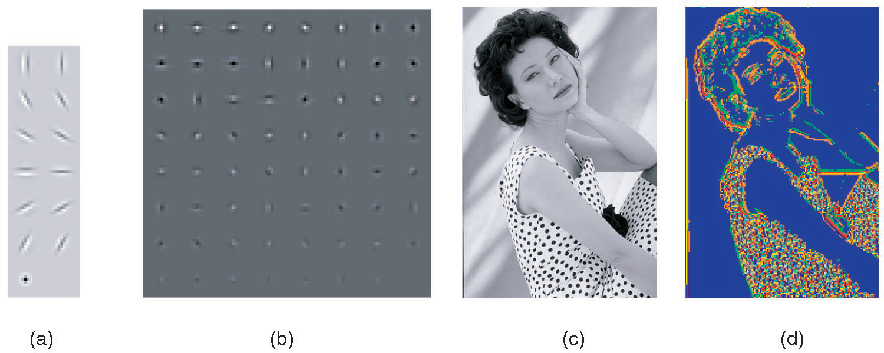
Texture features
Filterbank (13 filters)
Universal textons (64)
Image
Texton map (color-coded)
Martin, Fowlkes, Malik, 2004: Berkeley (Pb) edge detector

Slide 13


Localization
edges (due to large filters) are poorly localized; double peaks
Improve Localization by using derived feature
Divide by distance to nearest maximum
where f(x) is feature and the estimated distance to the nearest maximum of f(x) is

Slide 14
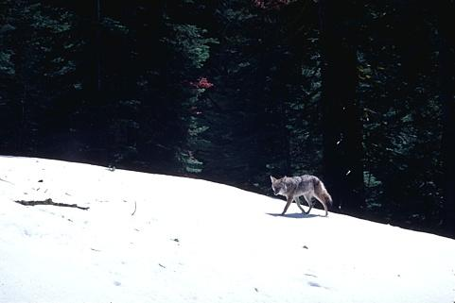
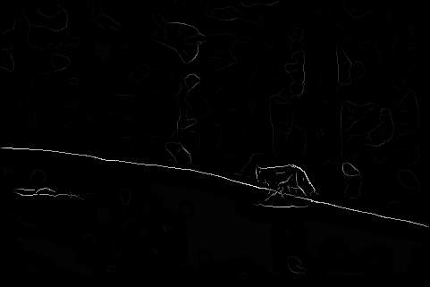
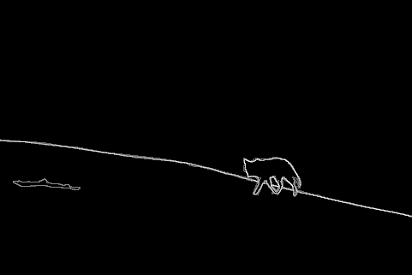
Results
Pb (0.88)
Human (0.95)

Slide 15

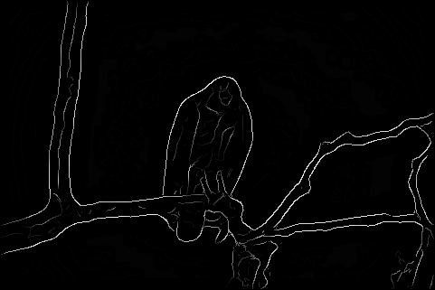
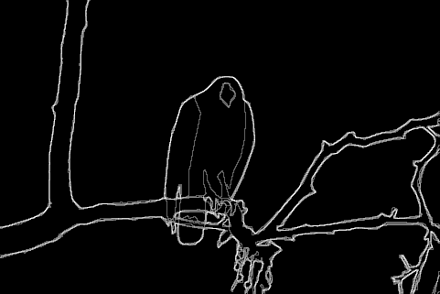
Results
Pb
Pb (0.88)
Global Pb
Human
Human (0.96)

Slide 16
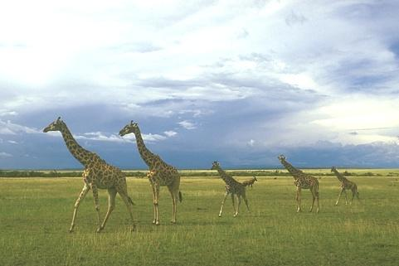
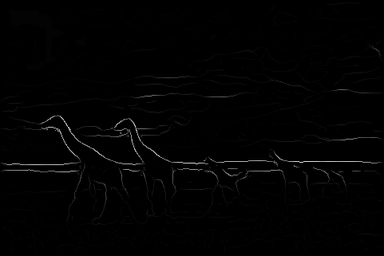
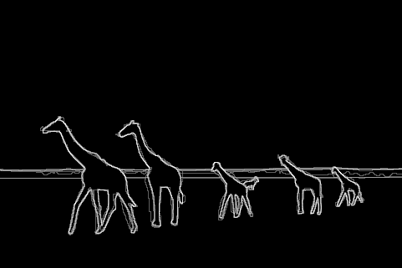
Pb (0.63)
Human (0.95)

Slide 17

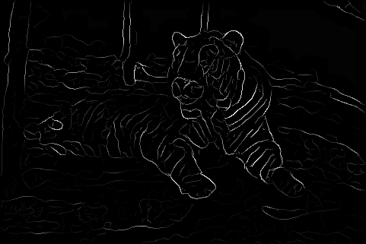

Pb (0.35)
Human (0.90)
For more: http://www.eecs.berkeley.edu/Research/Projects/CS/vision/bsds/bench/html/108082-color.html

